Slide 1


“DevSolver”
BANSAL INSTITUTE OF SCIENCE & TECHNOLOGY, BHOPAL
DEPARTMENT OF COMPUTER SCIENCE & ENGINEERING
Session Jan-June 2026
Project Group Member
1. Brajesh Prajapati
2. Ankit Kumar Singh
3. Gajendra Ahirwar
4. Boby Yadav
5. Divyansh Rathore
Prof.
Project Guide
Asst. Professor, CSE
Dr Kailash Patidar
Professor and Head, CSE

Slide 2
CONTENT
Abstract
Introduction
Existing Systems/Related Work (Literature Survey)
Methodology/Approach/Flow
Proposed System/Objectives
Technology Stack (H/W & S/W Requirement)/Tool
Conclusion
Future Scope
References

Slide 3
ABSTRACT
DevSolver is a web-based, developer-centric platform.
It helps programmers share, manage, and learn from real-world technical problem-solving experiences.
The platform focuses on structured blog-style solutions instead of short Q&A answers.
Users can create and manage technical blogs.
Administrators can moderate content and manage tags and users.
DevSolver enables community interaction and collaborative learning.

Slide 4
INTRODUCTION
Developers frequently face complex technical challenges requiring practical solutions.
Existing platforms often provide short or poorly structured answers.
Long-term learning and knowledge reuse are not effectively supported.
DevSolver addresses this gap through a centralized knowledge-sharing platform.
It enables developers to document and explore real-world solutions.
The system follows clean architecture, role-based access, and modern practices.

Slide 5
EXISTING SYSTEMS/RELATED WORK
Several platforms currently exist to support developer learning:
Stack Overflow – Focuses on question-answer format but lacks long-term solution context.
Medium / Dev.to – Provides blogs but lacks structured categorization and moderation.
GitHub Issues – Useful for project-specific discussions but not knowledge sharing.
Personal Blogs – Isolated and difficult to discover.
Limitations Identified:
Fragmented information
Poor categorization
Lack of moderation
No unified developer-focused learning environment

Slide 6
METHODOLOGY/APPROACH/FLOW
The system follows a full-stack, role-based architecture:
User accesses the Home Page
User registers or logs in
Authentication is performed using JWT
Role-based routing is applied:
User → User Dashboard
Admin → Admin Dashboard
Users can create, edit, and manage blogs
Admins can manage users and tags
Community section allows shared learning
The frontend is developed using React, while the backend is implemented using Spring Boot REST APIs connected to a relational database.

Slide 7
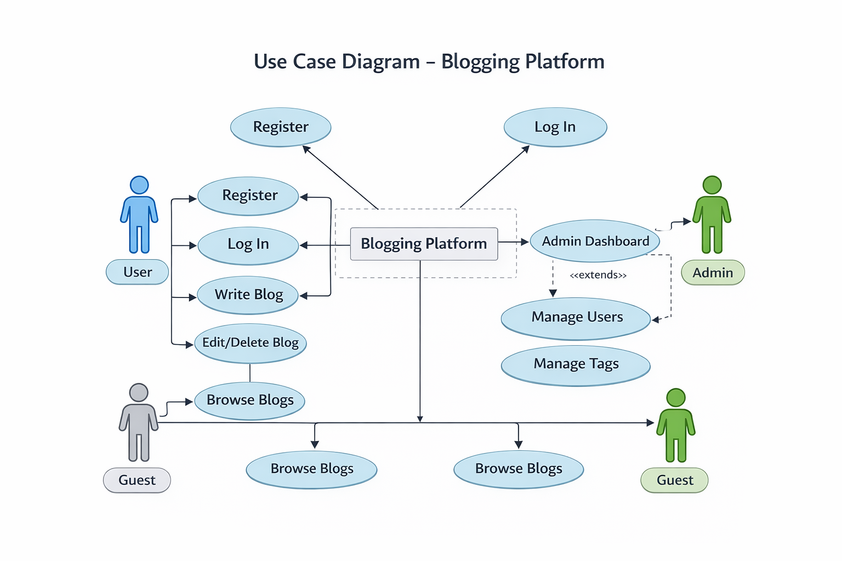
Use Case Diagram

Slide 8
PROPOSED SYSTEM/OBJECTIVES
Proposed System
DevSolver provides a centralized, secure, and scalable platform for developer knowledge sharing using curated tags and role-based access.
Objectives
Enable developers to document real-world solutions
Provide structured content through tagging
Ensure secure authentication and authorization
Support community-driven learning
Allow admin-level moderation and control

Slide 9
TECHNOLOGY STACK
Frontend
React (Vite)
Tailwind
Backend
Java 25
Spring Boot
Spring Security
JWT Authentication
JPA / Hibernate
Database
MySQL (Docker / Local)

Slide 10
SCREEN SHOTS/RESULTS

Slide 11
CONCLUSION AND FUTURE SCOPE
Conclusion
DevSolver successfully addresses the limitations of existing developer platforms by offering a structured, role-based, and scalable solution for knowledge sharing. The system demonstrates practical application of full-stack development concepts, authentication mechanisms, and clean architecture principles. It serves as a reliable platform for collaborative learning and real-world problem documentation.
Future Scope
Comment and reply system
Likes and bookmarks
Advanced search and filtering
Draft and autosave functionality
Analytics dashboard
Integration with GitHub
Cloud-based production deployment
Mobile application support

Slide 12
REFERENCES
Spring Boot Docs - https://spring.io/projects/spring-boot
React Docs - https://react.dev
Mozilla MDN Docs - https://developer.mozilla.org
Docker Docs - https://docs.docker.com
JWT Docs - https://jwt.io/introduction
StackOverFlow - https://stackoverflow.com

